Slide 1
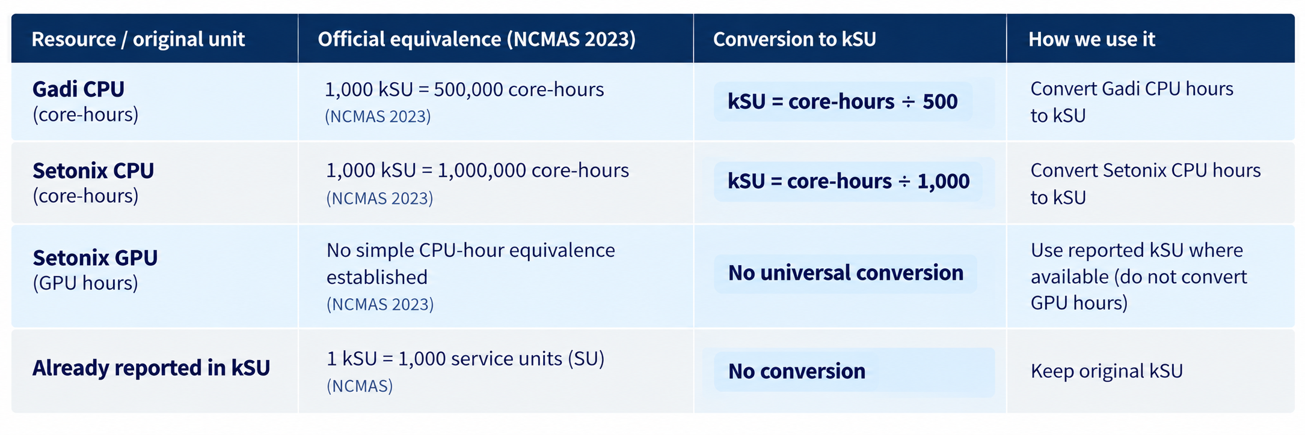
Data Conversion
Source: https://my.nci.org.au/mancini-assets/media/mas/ncmas/2023/NCMAS2023-NCMAS_2023_Info4Applicants_v5-20220830T164026AEST.pdf

Slide 2
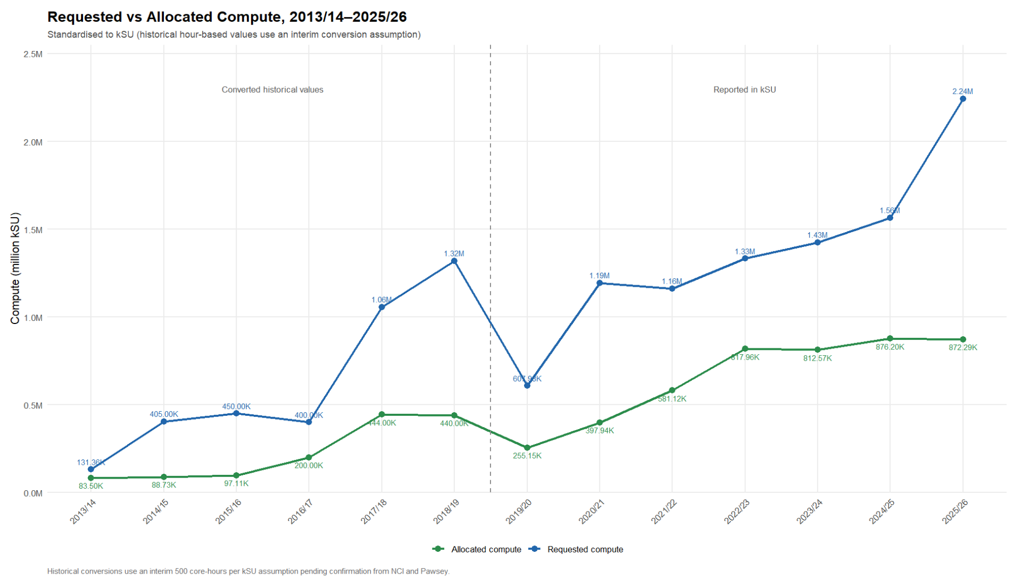
Notes:
Requested compute has grown much faster than allocated compute, especially in recent years. From 2022/23 to 2025/26, requests increased from 1.33M to 2.24M kSU, while allocations remained around 0.8 – 0.9M kSU. This shows a growing gap between researcher demand and available HPC resources.

Slide 3
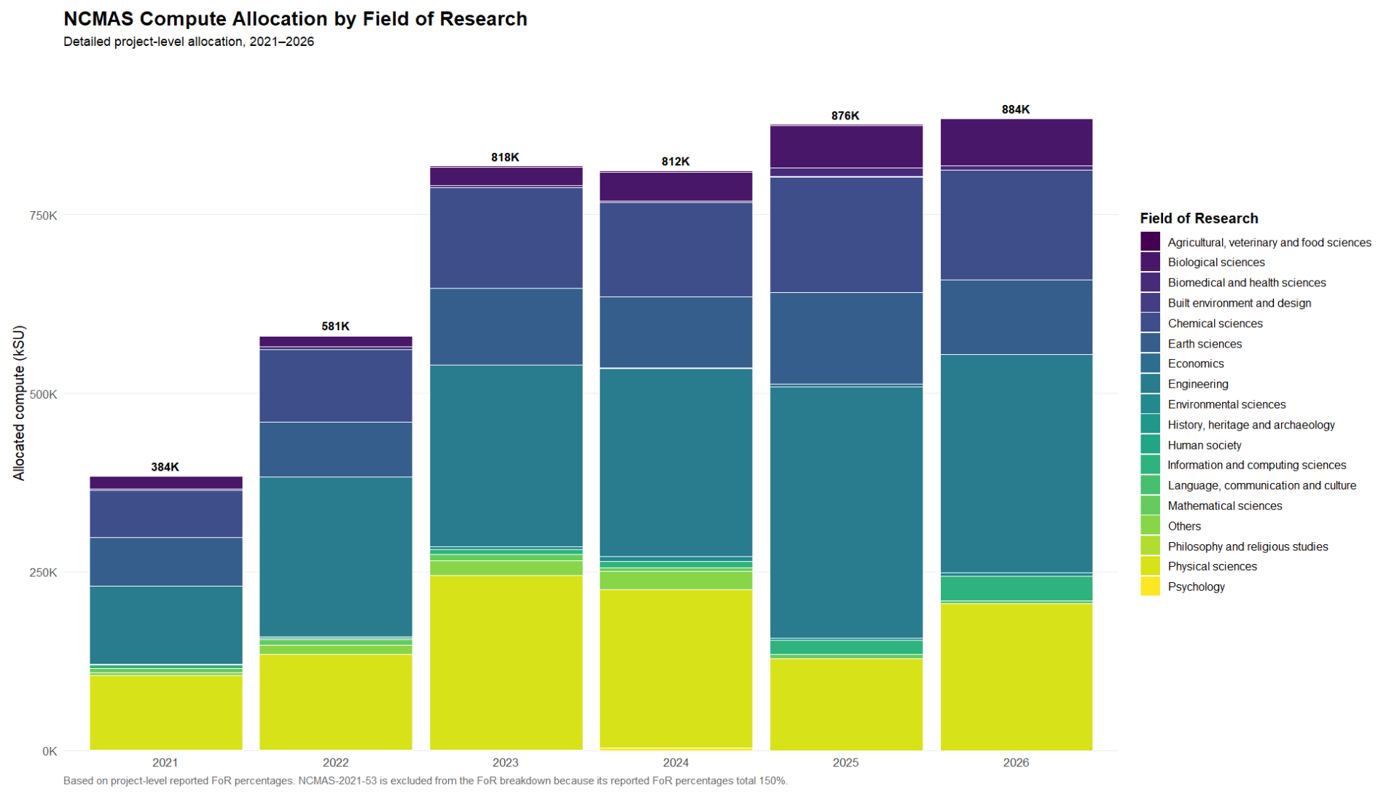
Notes:
Allocation increased strongly from 2021 to 2023, then remained relatively stable at around 0.8 – 0.9M kSU. Engineering, Physical Sciences and Chemical Sciences account for a large share of allocated compute across the six years. The composition also changes over time, showing that HPC allocation is not growing equally across research fields.

Slide 4
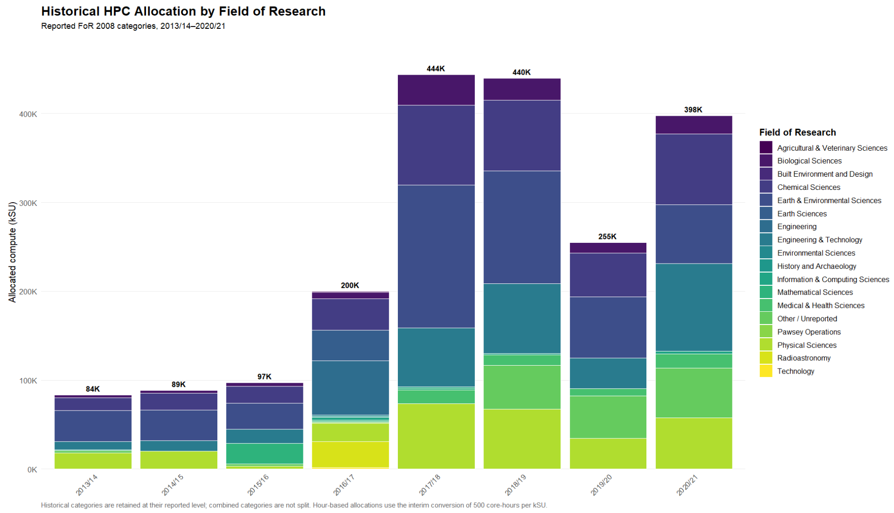
Notes:
HPC allocation increased substantially from 2013/14 to 2018/19, although historical unit conversions mean the trend should be interpreted cautiously. Earth/Environmental, Chemical, and Physical Sciences consistently account for large shares of allocation. The FoR mix also changes considerably across years, suggesting that compute use is spread differently across research fields over time.

